Slide 1
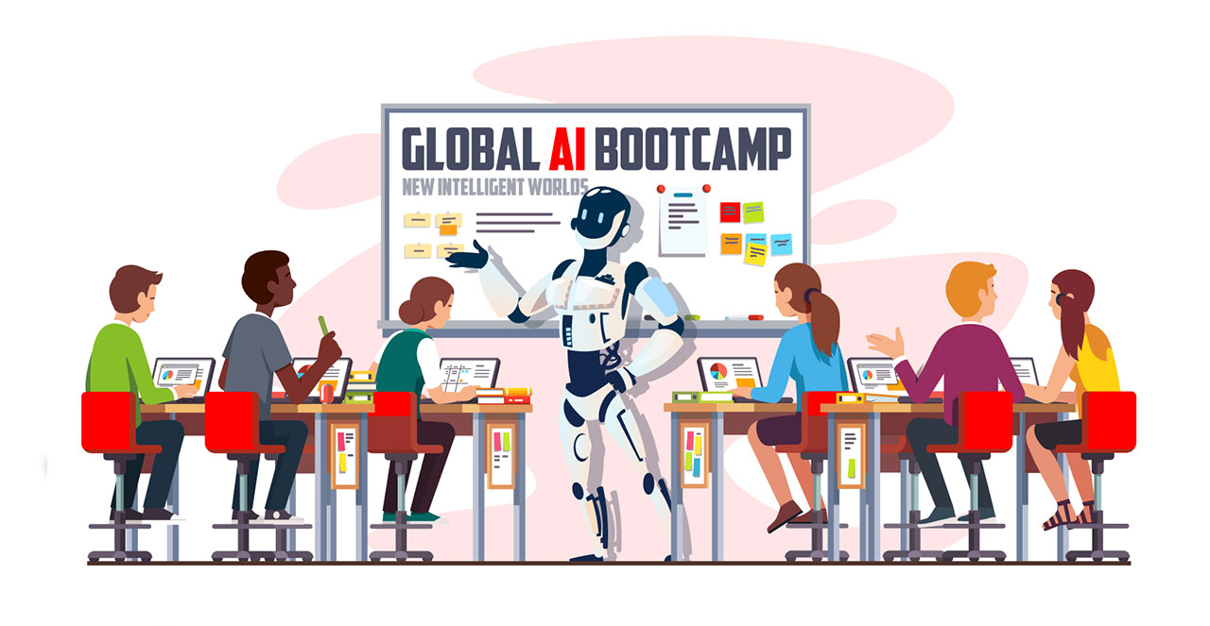
Global ai bootcamp: AI & Machine Learning
Bucharest December 15, 2018 #BucharestAIBootcamp #GlobalAIBootcamp

Slide 2
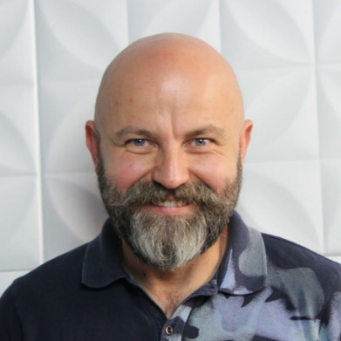
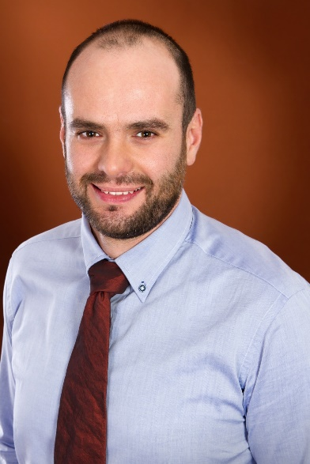
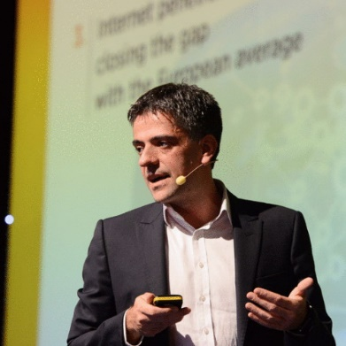
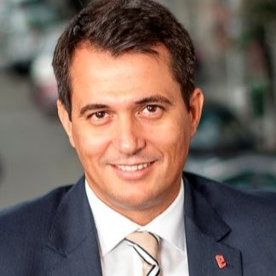
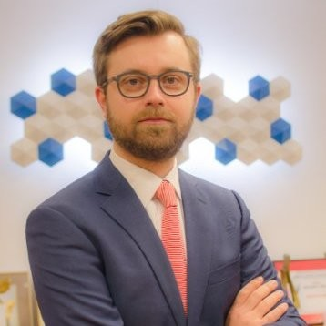
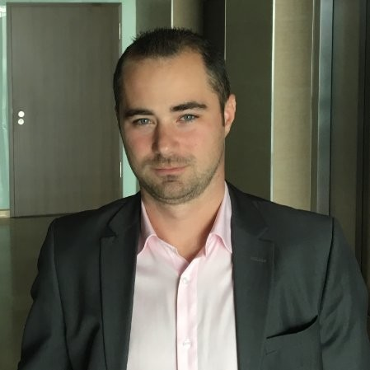
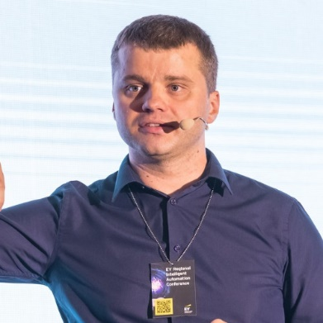
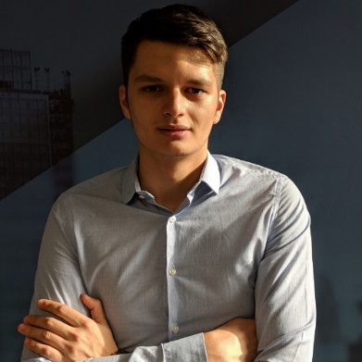
The Speakers #BucharestAIBootcamp #GlobalAIBootcamp
Sergiu Negut
Business Angel
Adrian Blidarus
Softelligence
Konstantinos Tovil TBI
Marian Ignat
BCR
Liviu Huluta Marsh
Daniel Jinga Softelligence
Sorin Peste
Microsoft
Laurentiu Diaconu Softelligence

Slide 3
Agenda #BucharestAIBootcamp
10:00 - 10:20 | Opening Remarks
10:20 - 10:50 | Keynote: AI | Sergiu Negut Business Growth Consultant and Associated Dean with Maastricht School of Management
10:50 - 11:00 | Break
11:00 - 11:50 | AI: what you need to tell your CEO | Adrian Blidarus Founder and CEO, Softelligence
11:50 - 12:40 | Building the Business Case for A.I. in Financial Services | Konstantinos Tovil Senior Vice President E-Commerce, TBI Bank Marian Ignat Executive Director Digital Banking, BCR Liviu Huluta Head of Consumer & Commercial for Central, Southern and Eastern Europe, Marsh Panel discussion facilitated by Daniel Jinga Business Development Manager CEE, Softelligence
12:45 - 13:30 | Lunch
13:30 - 15:00 | Workshop #1: Using Custom Vision for Object Classification and Detection | Sorin Peste Technical Evangelist Data & AI, Microsoft
15:00 - 15:15 | Break
15:15 - 16:45 | Workshop #2: Fraudulent Claim Detection in Insurance Using Azure Machine Learning Studio | Laurentiu Diaconu Data Scientist, Softelligence
16:45 - 17:00 | Conclusions

Slide 4
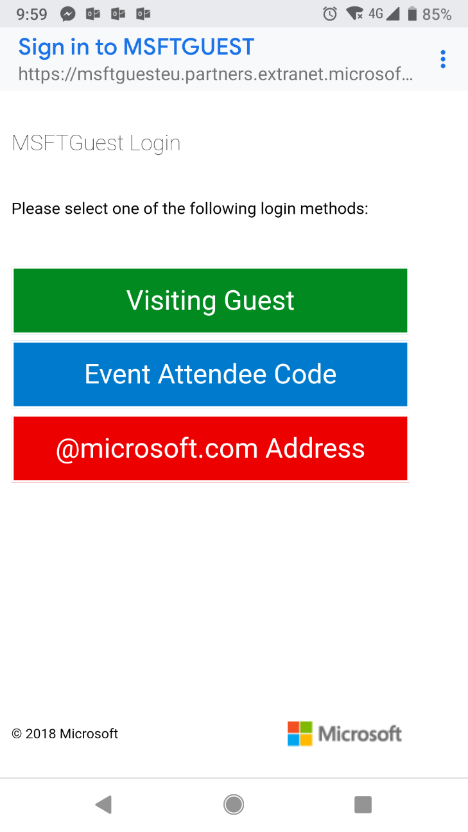
WiFi Access
Connection MSFTGUEST
Use Event Attendee Code msevent297fb
#BucharestAIBootcamp #GlobalAIBootcamp

Slide 5




Sponsors & Supporters
Organizer & Coffee Break Sponsor
Event Host
Lunch Break Sponsor
Raffle Sponsor
Winners announced at the end!
#BucharestAIBootcamp #GlobalAIBootcamp

Slide 6
Up Next Keynote: AI
Speaker: Sergiu Negut
Business Growth Consultant and Associated Dean with Maastricht School of Management
10:20-10:50
#BucharestAIBootcamp
#GlobalAIBootcamp

Slide 7
Coffee Break #BucharestAIBootcamp 10:50-11:00 ⇨ next session: AI: what you need to tell your CEO Adrian Blidarus WiFi MSFTGUEST use Event Attendee Code msevent297fb

Slide 8
Artificial Intelligence: what you need TO TELL YOUR CEO
Adrian Blidarus Founder & CEO, Softelligence
November 2018
#BucharestAIBootcamp
#GlobalAIBootcamp

Slide 9

What Is Artificial Intelligence And Why Does It Matter?
Artificial Intelligence is the theory and development of computer systems able to perform tasks normally requiring human intelligence, such as reasoning, adapting and learning.
Machine Learning is the study of algorithms and mathematical models that computer systems use to progressively improve their performance on a specific task.
#BucharestAIBootcamp #GlobalAIBootcamp

Slide 10
A Paradigm Change
From getting results
Input + Algorithm
= Output
To understanding the world and making connections
Input + Output
= Algorithm
#BucharestAIBootcamp #GlobalAIBootcamp

Slide 11
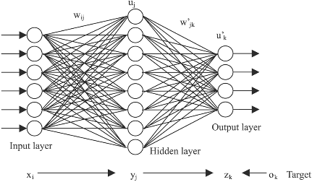
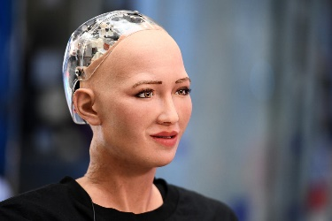
What Is Artificial Intelligence trying to achieve ?
Surpass humans
Simulate humans
Predictive modeling
Anomaly detection
Text
mining
Facial
recognition
Classification
Image
recognition
Natural Language
Processing
Sentiment recognition
Source: Clement Brunet, The Co-operators (presented at Insurance Nexus Analytics Summit 2018, Toronto, Canada)
#BucharestAIBootcamp #GlobalAIBootcamp

Slide 12


Managing difficulties
Areas where CEOs believe their role is more difficult that they were expecting.
Driving cultural change is the greatest difficulty in a CEO’s role.
50% | 48% | 47% | 40% | 35% | 31% | 25% | 23% | 20% | 18%
Driving cultural change | Finding time for myself for reflection | Developing my senior leadership team | Balancing short-term financials with longer-term company transformation | Managing the impact on my family/personal life | Maintaining my physical health | Engaing with external shareholders | Engaging with internal shareholders | Managing my stress levels | Connecting with my peers
Source: Egon Zehnder 2018

Slide 13

Three Myths About AI
Myth #1:
The main challenge is technology.
The main challenge is technology.
The main challenge is people.
AI in an enabler.
Business models are disruptive.
Myth #2:
AI is a disruptor.
AI is a disruptor.
Myth #3:
AI generates benefits.
AI generates benefits.
AI generates potential.
#BucharestAIBootcamp #GlobalAIBootcamp

Slide 14



Business Strategies for Delivering Innovation
Strategy 1 Go All-In
Take the leap of faith to create a spin-off company focused 100% on innovation.
Example: Aviva Digital Garage
Risk level: 
Strategy 2 Corporate Lab
Creating internal pockets of innovation within the larger company by putting in place a team dedicated to delivering pilot projects and Proofs of Concept.
Example: Beazley Labs
Risk level: 
Strategy 3 The Investor
Make small, targeted investments in other independent companies that deal with innovation rather than put your own company at risk.
Example: Alphabet Inc.
Risk level: 
#BucharestAIBootcamp #GlobalAIBootcamp

Slide 15


But what are the real-world business problems
we are trying to solve with AI?

Slide 16
Generic Use Cases for AI
Better customer experience
Reduce Expenses
Optimize Sales Efforts
Better risk management (through more accurate predictions)
Brand Differentiator
Improve Quality
Reduce Errors
#BucharestAIBootcamp #GlobalAIBootcamp

Slide 17

Intelligent Automation Applications in Insurance

Slide 18

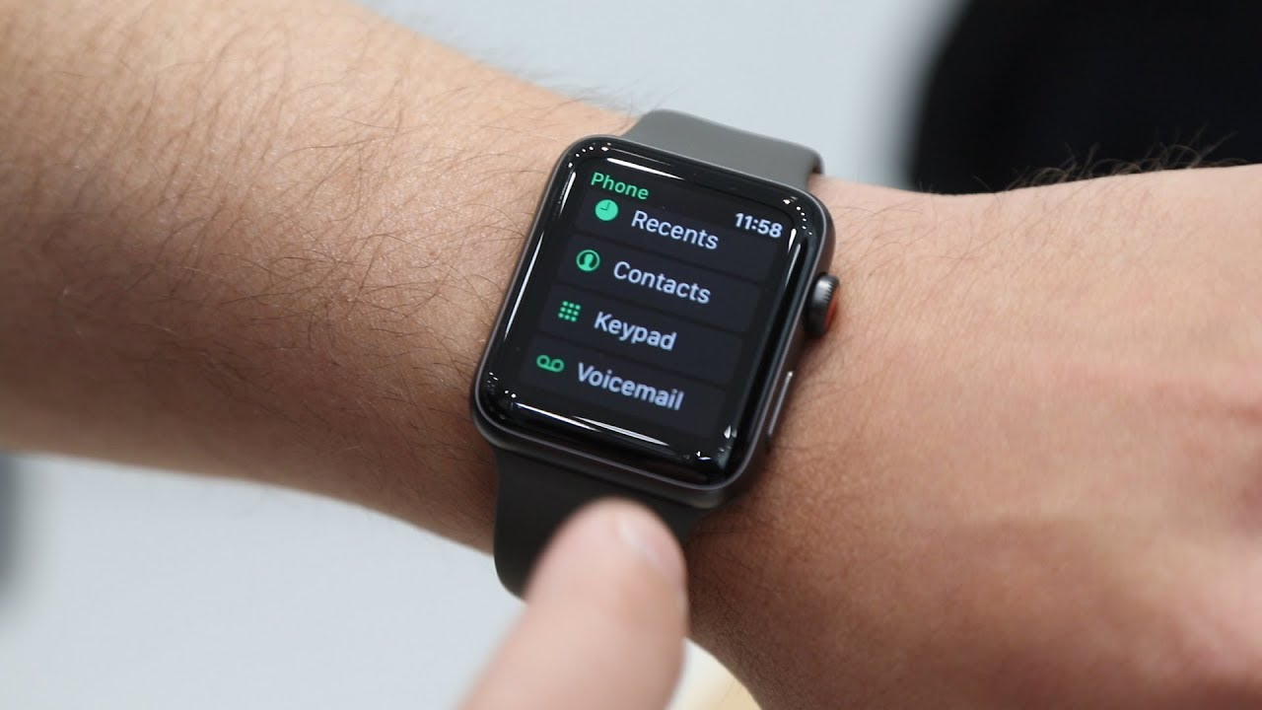

Change Agents
Mobile
Artificial Intelligence
+255%
Year-on-Year increase in mobile claims (2018 vs. 2017)
Internet of Things
Source: CCC Industry Data Extrapolations
#BucharestAIBootcamp #GlobalAIBootcamp

Slide 19
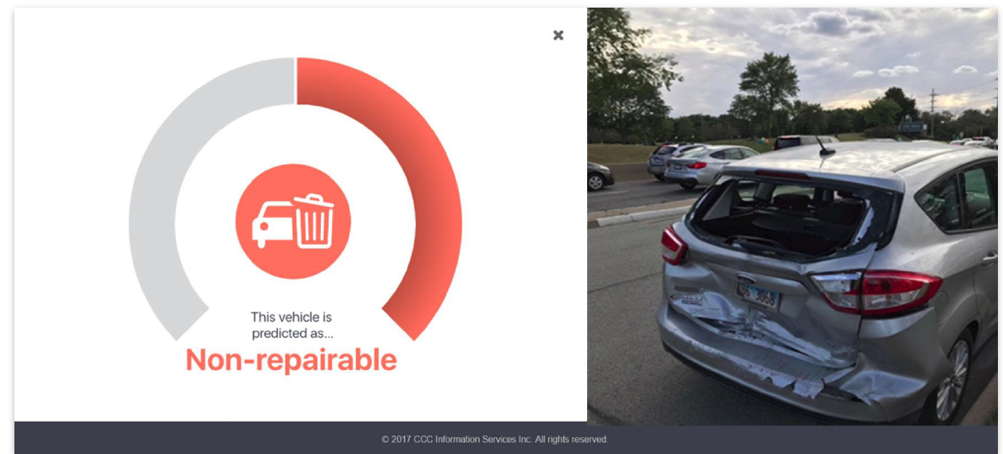
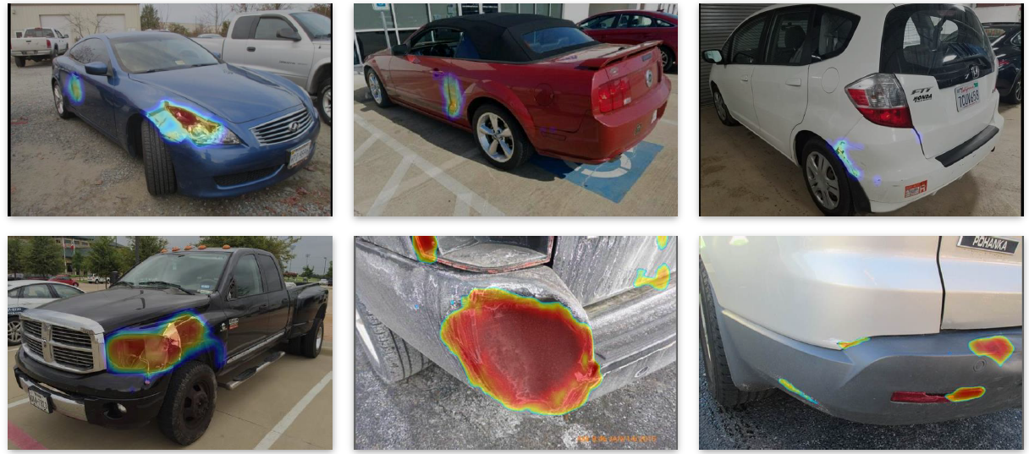
AI use cases in Insurance Claims
Chatbots
Virtual Inspection
Detection (Damage & Total Loss)
Auditing
Estimation
Insights
Damage Detection
#BucharestAIBootcamp #GlobalAIBootcamp

Slide 20
Example focus: leveraging data to deliver a seamless customer experience in a Home insurance policy purchase scenario
Goal: minimize the # of questions asked when buying home insurance from a Canadian insurance carrier
Benefits:
Improve customer experience
Increase sales/conversion %
Decrease purchase abandon %
Data sources:
Internal and External Data
Structured and Unstructured Data
# Questions
Few (<3)
Medium (<5)
High (5+)
~20%
~60%
~20%
#BucharestAIBootcamp #GlobalAIBootcamp

Slide 21

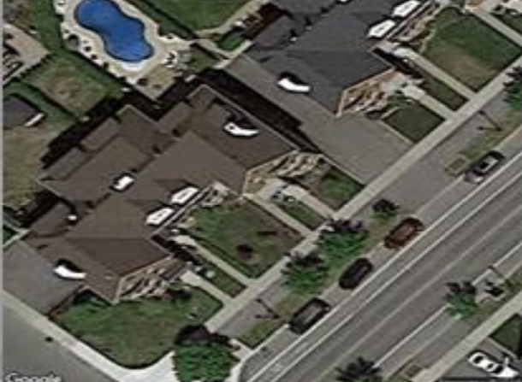
Leveraging Unstructured Data in Deep Learning on Images
Street View
Sattelite View
Type of output:
Number of stories
Type of garage
Chimneys
Construction year
Number of windows
Type of output:
Pool
Garden size
Trees in proximity
#BucharestAIBootcamp #GlobalAIBootcamp

Slide 22
So what do we do next?

Slide 23

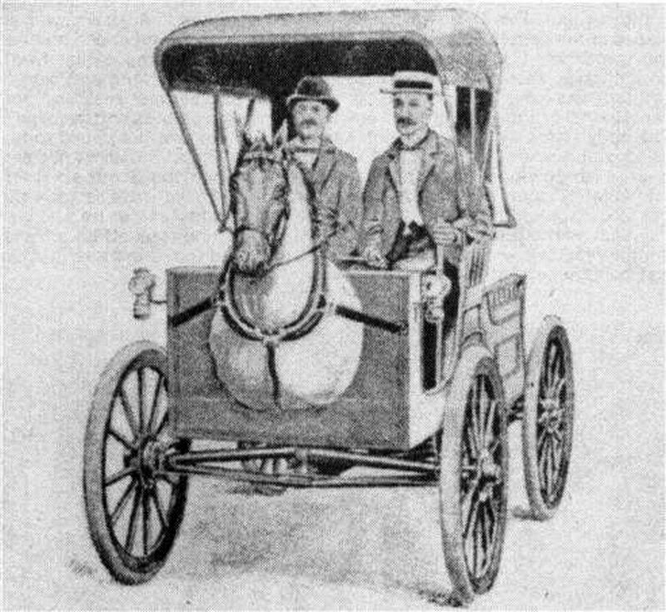
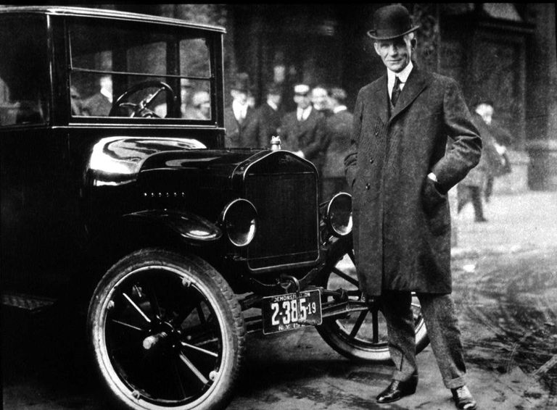
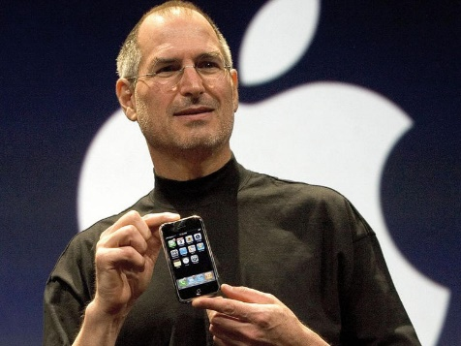
Making It Happen
Insight: by nature people ( e.g. CEO’s ) are reluctant to change. To overcome this, both a cross-functional cultural shift is needed as well as adopting a mindset of change and ongoing experimentation.
”
If I had asked people what they wanted, they would have said: faster horses.
– Henry Ford
”
It’s really hard to design products by focus groups. A lot of times, people don’t know what they want until you show them.
– Steve Jobs
#BucharestAIBootcamp #GlobalAIBootcamp

Slide 24
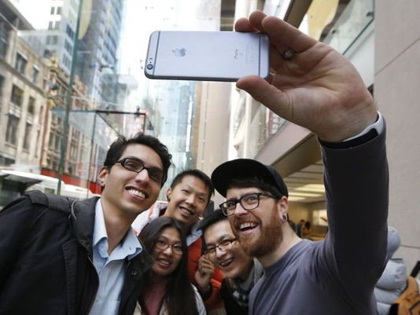





Step 1 Rethink
customer experience
Step 2 Redefine the role of the advisor
Step 3 Do a strategic workforce planning excercise
Step 4 Define what
success means
Step 5 Engage the business sponsor
Step 6 Experiment, measure and iterate
#BucharestAIBootcamp #GlobalAIBootcamp

Slide 25

Takeaways
AI works today. It relies on prototyping, iterations, learning and exercise.
AI is not a matter of technology or cost, but a matter of people, culture and mentality.
The real disruption is the business strategy.

Slide 26
“To survive and flourish in such a world, you will need a lot of mental flexibility and a great reserves of emotional balance.” Yuval Noah Harari
How fast can you change?

Slide 27
Questions?
Adrian Blidarus
Founder & CEO
Softelligence
learn more at softelligence.net

Slide 28



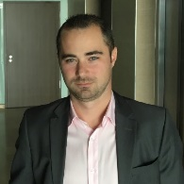
HAPPENING NOW Building the Business Case for A.I. in Financial Services
Panel discussion
11:50-12:40
Konstantinos Tovil Senior Vice President Digital Retail, TBI Bank
Marian Ignat Executive Director Digital Banking, BCR
Liviu Huluta Head of Consumer & Commercial for
Central, Southern and Eastern Europe, Marsh
#BucharestAIBootcamp
#GlobalAIBootcamp
Facilitator: Daniel Jinga
Business Development Manager CEE, Softelligence

Slide 29
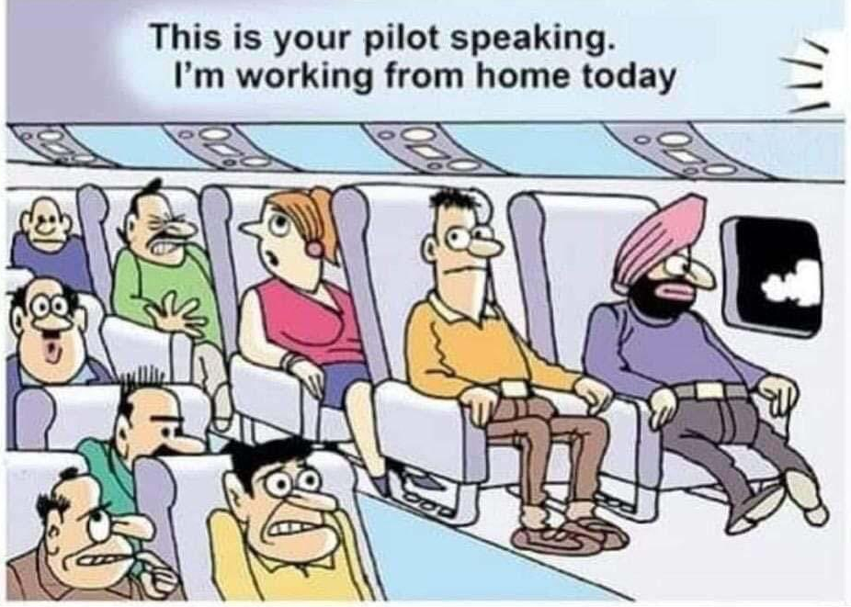
Panel Building the Business Case for A.I. in Financial Services
Panel discussion 11:50-12:40
Konstantinos Tovil Senior Vice President
Digital Retail, TBI Bank
Marian Ignat Executive Director Digital Banking, BCR
Liviu Huluta Head of Consumer & Commercial for
Central, Southern and Eastern Europe, Marsh
Facilitator: Daniel Jinga
Business Development Manager CEE, Softelligence
#BucharestAIBootcamp #GlobalAIBootcamp

Slide 30
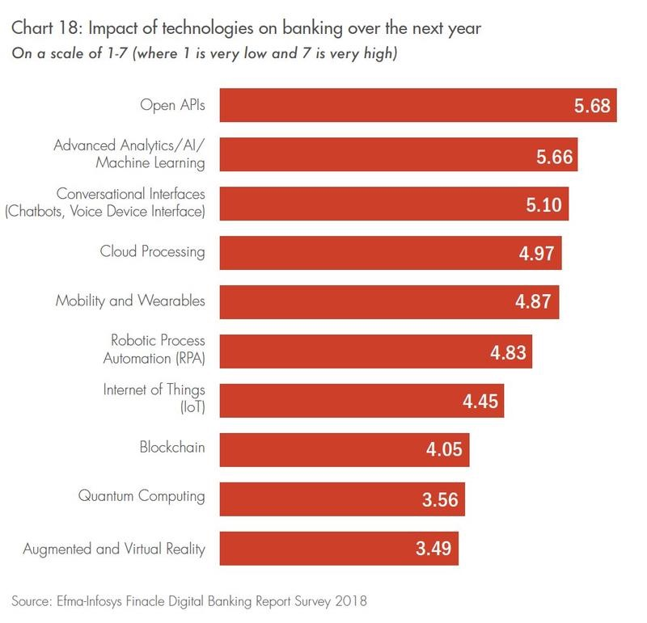
Panel Building the Business Case for A.I. in Financial Services
#BucharestAIBootcamp #GlobalAIBootcamp

Slide 31
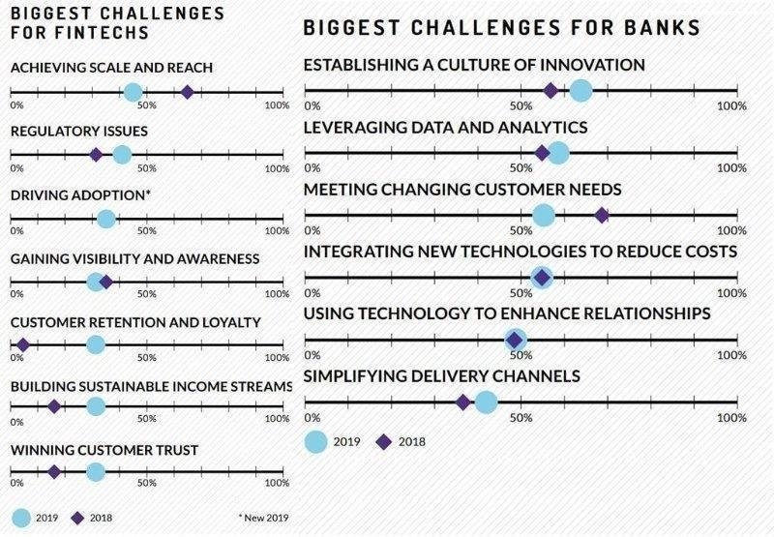
Panel Building the Business Case for A.I. in Financial Services
#BucharestAIBootcamp #GlobalAIBootcamp

Slide 32

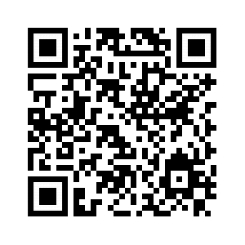
Lunch Break #BucharestAIBootcamp 12:45-13:30 ⇨ next workshop: Using Custom Vision for Object Classification and Detection Sorin Peste Check out the workshops on GitHub at bit.ly/BucharestAIBootcamp or scan the QR code WiFi MSFTGUEST use Event Attendee Code msevent297fb

Slide 33
Workshop #1 Using Custom Vision for Object Classification and Detection
Speaker: Sorin Peste
Technical Evangelist Data & AI, Microsoft
13:30-15:00
#BucharestAIBootcamp
#GlobalAIBootcamp
Important:
Your laptop is required in order to practice each step of the workshop.
Check out this workshop on GitHub at bit.ly/BucharestAIBootcamp.

Slide 34
Break #BucharestAIBootcamp 15:00-15:15 ⇨ next workshop Fraudulent Claim Detection in Insurance Using Azure Machine Learning Studio Laurentiu Diaconu Check out the workshops on GitHub at bit.ly/BucharestAIBootcamp or scan the QR code WiFi MSFTGUEST use Event Attendee Code msevent297fb

Slide 35
Workshop #2 Fraudulent Claim Detection in Insurance Using Azure Machine Learning Studio
Speaker: Laurentiu Diaconu
Data Scientist, Softelligence
15:15-16:45
#BucharestAIBootcamp
#GlobalAIBootcamp
Important:
Your laptop is required in order to practice each step of the workshop.
Check out this workshop on GitHub at bit.ly/BucharestAIBootcamp.

Slide 36

That’s a wrap! #BucharestAIBootcamp #GlobalAIBootcamp Winners announced. Workshops available on GitHub at bit.ly/BucharestAIBootcamp Thank you for your participation and please fill in the survey at bit.ly/AIBootcampSurvey
Sponsors

Slide 37

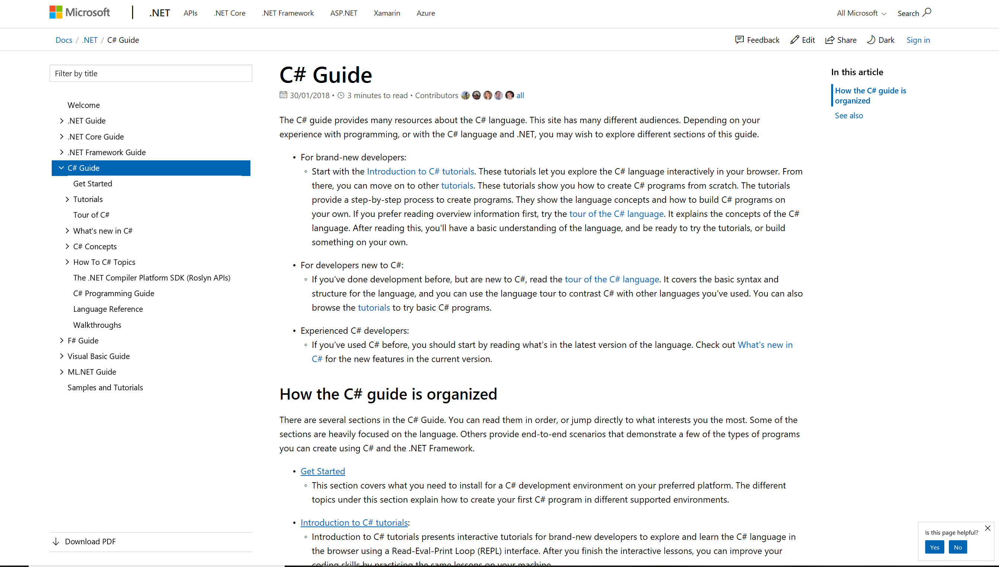
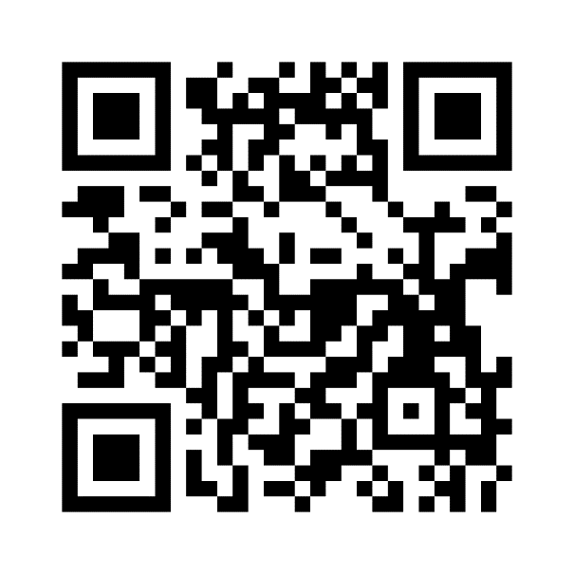
Docs.microsoft.com
One global service. The latest in technical documentation, training and solutions.
Scan the QR code below for
AI documentation and examples
Notes:
65 languages;
global by default
Foundation on Git
Replaces MSDN/TechNet Online

Slide 38
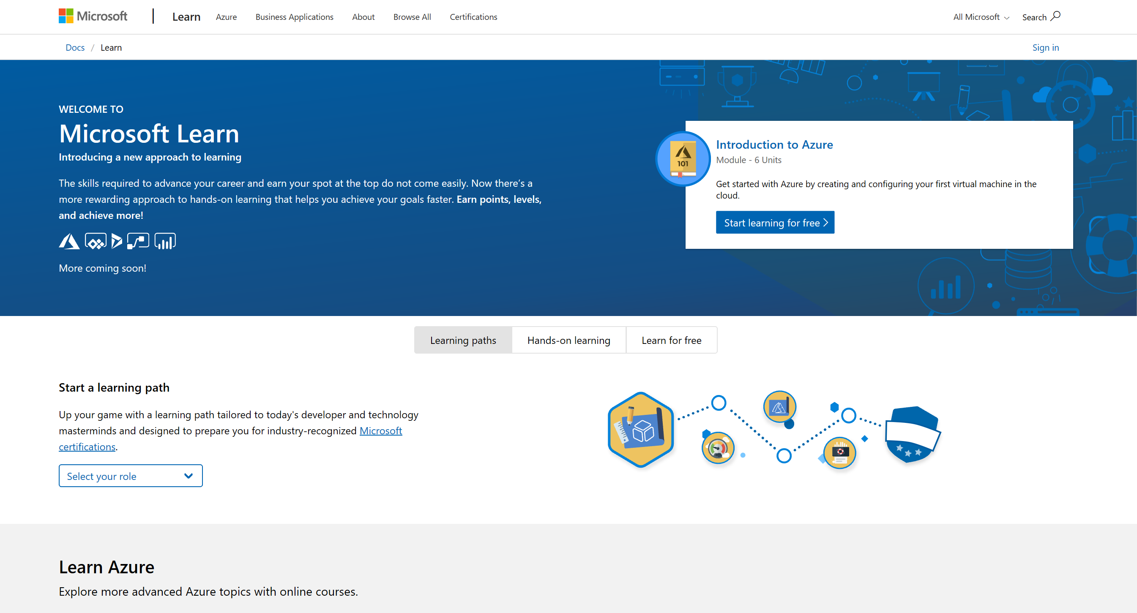
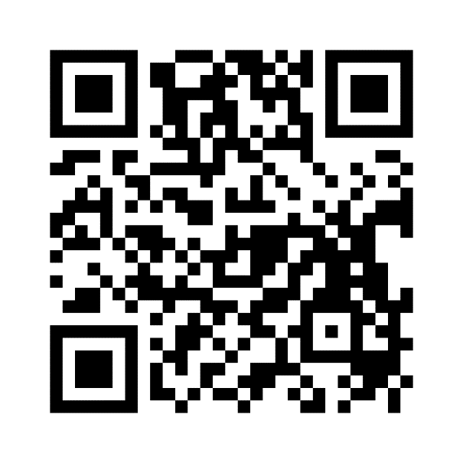
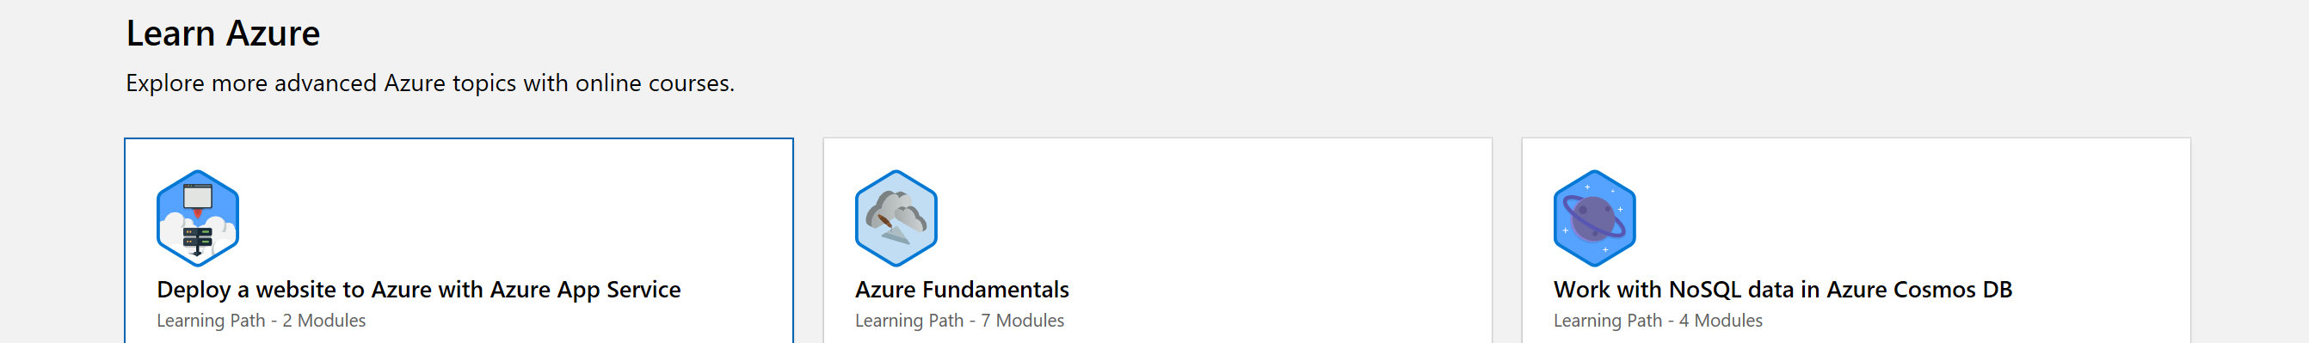
Microsoft Learn
Friction-free online learning. Have fun, unlock achievements, and get certified.
Scan the QR code below for
AI Microsoft Learn resources

